Slide 1
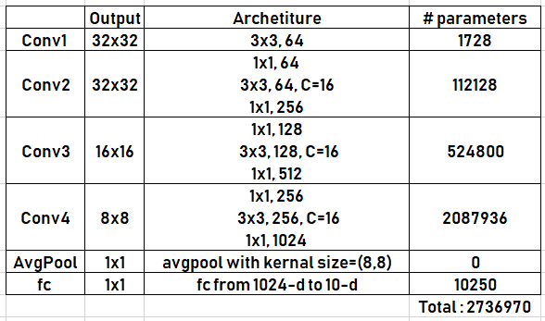
X3
X3
X3

